Slide 1
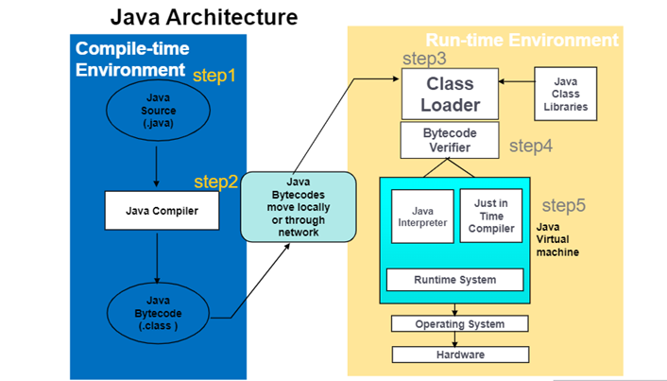

Slide 2
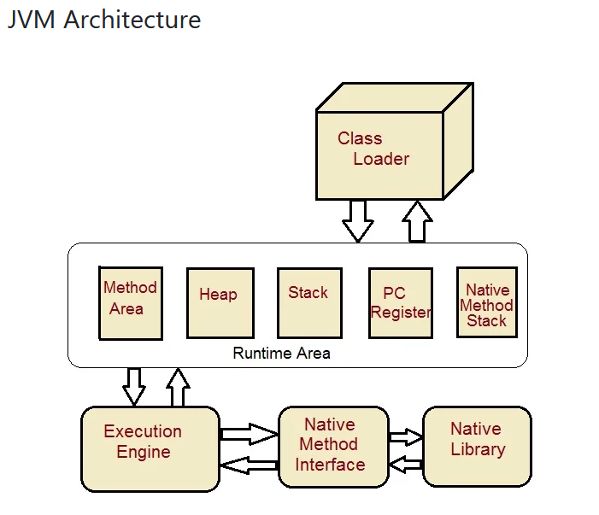

Slide 3
JDK, JRE and JVM
JDK JRE and JVM are interrelated, there is a wide range of differences between the three. First, let’s understand the meaning of all three terms and their implications individually, then we shall discuss their differences on various bases.

Slide 4
What is JDK?
JDK is an abbreviation for Java Development Kit. It is a software development kit used for Java applications and applet development. JDK is platform-dependent, so separate installers are needed for Windows, Unix, and Mac operating systems.
It is responsible for code execution and consists of both JVM and JRE. The Java Development Kit (JDK) includes all of the tools, executables, and binaries needed to compile, debug, and run Java programs. This consists of a compiler, an archiver, a debugger, Java Runtime Environment (JRE), and other Development tools.

Slide 5
JDK Architecture
JDK consists of both JRE and JVM.
JDK and JRE: The JDK allows programmers to write core Java programs that can be executed by the JRE, which includes the JVM and class libraries.
Class Libraries: It is a collection of dynamically loadable libraries that Java programmers can use during runtime.
Compilers: Javac is the primary compiler in Java. It is a Java application that accepts developers’ text files and compiles them into Java class files. It is the most frequent type of output given by a compiler that contains Java byte code.
Debuggers: This helps developers in testing and debugging Java programs.
JavaDoc: It is documentation made by Sun Microsystems for Java. It can be used in HTML files to generate API documentation from the source program.

Slide 6
What is JRE?
JRE stands for Java Runtime Environment, and it is the implementation of JVM, i.e. the specifications used in JVM are implemented, and an environment for code execution is created. JRE is primarily made up of Java binaries and other classes used to execute programs the same way JVM does.
Along with Java binaries, JRE also includes:
Deployment technologies.
User interfaces for interacting with the code being executed.
Base libraries for different functionalities and JVM.
It does not contain any tools like a debugger, compiler, etc., for Java development. Developers can simply run source code with JRE, but they cannot develop or compile Java programs.

Slide 7
JRE Architecture
JRE includes a JVM instance, library classes, and development tools. When you write and compile Java code, the compiler produces a class file containing byte code.
Here are the components of JRE:
Class loaders: This helps in loading various classes that are necessary for running Java programs. JVM mainly uses three class loaders: the system class loader, bootstrap class loader and extensions class loader.
Byte code verifier: It verifies the bytecode so that the code does not disturb the interpreter.
Interpreter: The interpreter reads the code line by line after the classes get loaded, and the code gets verified.
Run-time: Run-time is a system mainly used in programs to tell the time period of a particular program when it is running.
Hardware: After the Java native code is completed, it is executed on a specific hardware platform. In this way, Java programs run in the Java Runtime Environment.

Slide 8
What is JVM?
JVM is an acronym for Java virtual machine, which is a specification that offers a runtime environment in which Java byte code can be executed. The JVM is in charge of translating Bytecode to machine-specific code.
It can also implement programs written in other languages and compiled into Java bytecode. It cannot be downloaded and installed separately. JRE must be installed before JVM can be installed.
JVM provides a platform-independent way for executing Java source code. JVM includes a JIT (Just-in-Time) compiler that converts Java source code to low-level machine language at runtime. As a result, it performs better than a regular application.

Slide 9
JVM Architecture
JVM contains numerous tools, libraries, and frameworks. It is mainly responsible for the following tasks: Loads code, verifies code, executes code, and provides a runtime environment.

Slide 10
Here are the components of JVM:
ClassLoader – It is a subsystem mainly used for loading the class files. It performs three primary functions, i.e. Loading, Linking, and Initialising.
Method Area- It stores a class structure like metadata, Java methods, and constant runtime pool.
Heap Memory- All the objects, instance variables, and arrays are stored in a heap. This memory is shared across numerous threads.
JVM language Stacks- It stores local variables and their partial results. Every thread has its own JVM language stack, which is generated simultaneously as the thread. When a method is called, a new frame is generated, and it is deleted once the method has been called.
PC Registers- The address of the presently executing Java virtual machine instruction is stored in PC registers. Each thread in Java has its own set of PC registers.
Native Method Stacks- The instructions of native code are stored in native method stacks, which are dependent on the native library. It utilises native heaps or any form of the stack to allocate memory.
Execution Engine- It is a sort of software used to test hardware, software, or whole systems. The test execution engine never stores any data about the product being tested.
Native Method interface- It is a programming framework. It allows libraries and native programmes to call Java code executing in a JVM.
Native Method Libraries- It is a collection of Native Libraries (C, C++) that the Execution Engine requires.

Slide 11
Basis | JDK | JRE | JVM
Definition | Java Development Kit (JDK) is a software development kit used to develop Java applications. | Java Runtime Environment (JRE) is a software package that provides Java Virtual Machine (JVM), class libraries and other components to run applications in Java. | Java Virtual Machine (JVM) is an abstract machine that provides an environment for the execution of Java ByteCodes.
Tools | JDK contains tools for developing, monitoring and debugging java codes. | JRE contains class libraries and other supporting files required by JVM for executing Java programs. | JVM does not include any software development tools.
Platform-dependency | It is platform-dependent, i.e. different platforms require different JDK. | It is also platform-dependent as JDK. | It is platform-independent.
Functionality | It is primarily used for creating Java programs that JRE and JVM can execute. | It is mainly responsible for creating an environment for the execution of Java programs. | JVM specifies all the implementations and is responsible for providing them to JRE.
Implementation | JDK = JRE + Development tools | JRE = JVM + Class libraries | JVM = provides a runtime environment.

Slide 12
Relation between JDK vs JRE vs JVM
JDK is a superset of JRE, containing all of the tools for developing applets and applications included in JRE, such as compilers and debuggers. The Java Runtime Environment (JRE) contains libraries, the Java Virtual Machine (JVM), and other components for running Java applets and applications.
JVM is the key element of both JDK and JRE. Whatever Java program you run using JRE or JDK goes into JVM, and it is responsible for executing the program line by line. Hence it is also known as an interpreter. The figure below shows the relationship between the three.

Slide 14
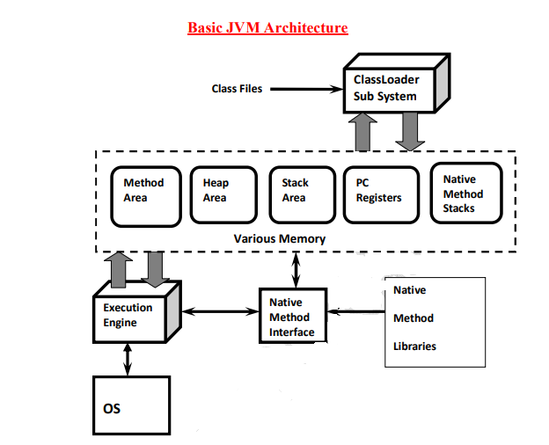

Slide 15
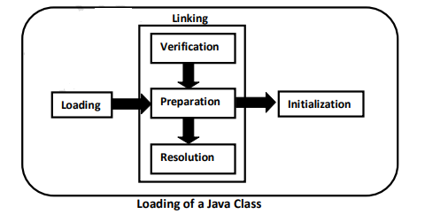

Slide 16
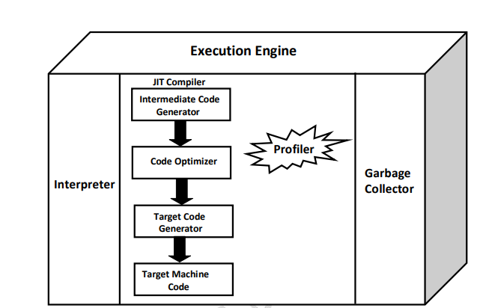

Slide 17
The execution engine
The execution engine is the Central Component of the java virtual machine(JVM). It communicates with various memory areas of the JVM. Each thread of a running application is a distinct instance of the virtual machine’s execution engine. Execution engine executes the byte code which is assigned to the run time data areas in JVM via class loader. Java Class files are executed by the execution engine.

Slide 18
Interpreter:
It reads the byte code and interprets(convert) into the machine code(native code) and executes them in a sequential manner. This component runs the application from the command line by accepting a filename argument. The problem with the interpreter is that it interprets every time, even the same method multiple times, which reduces the performance of the system. To overcome this problem JIT Compilers is introduced in 1.1 version.

Slide 19
JIT Compiler:
JIT compiler counterbalances the interpreter’s disadvantage of slow execution and improves the performance.At run time, the JVM loads the class files, the semantic of each is determined and appropriate computations are performed. The additional processor and memory usage during interpretation makes a Java application perform slowly as compared to a native application.
The JIT compiler aids in improving the performance of Java programs by compiling bytecode into native machine code at run time.
The JIT compiler is enabled throughout, while it gets activated when a method is invoked. For a compiled method, the JVM directly calls the compiled code, instead of interpreting it. Theoretically speaking, If compiling did not require any processor time or memory usage, the speed of a native compiler and that of a Java compiler would have been same.

Slide 20
JIT compilation requires processor time and memory usage. When the java virtual machine first starts up, thousands of methods are invoked. Compiling all these methods can significantly affect startup time, even if the end result is a very good performance optimization.
Profiler: This is a tool which is the part of JIT Compiler is responsible to monitor the java bytecode constructs and operations at the JVM level.

Slide 21
Garbage Collector:
This is a program in java that manages the memory automatically. It is a daemon thread which always runs in the background. This basically frees up the heap memory by destroying unreachable methods.

Slide 22
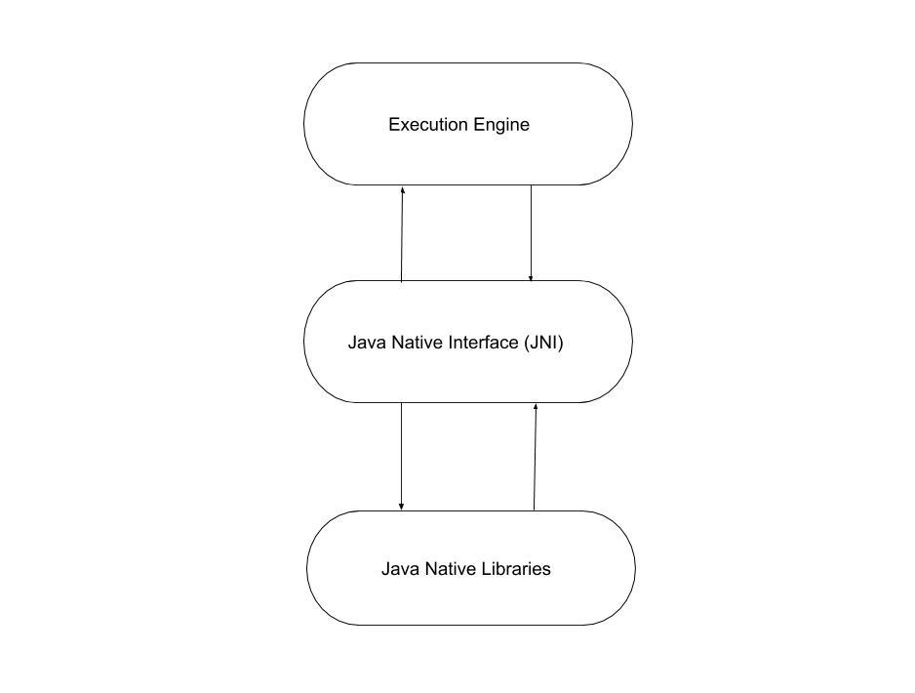
Java Native Interface(JNI): JNI acts as a bridge(mediator) between java method calls and corresponding native libraries. That is:

Slide 23
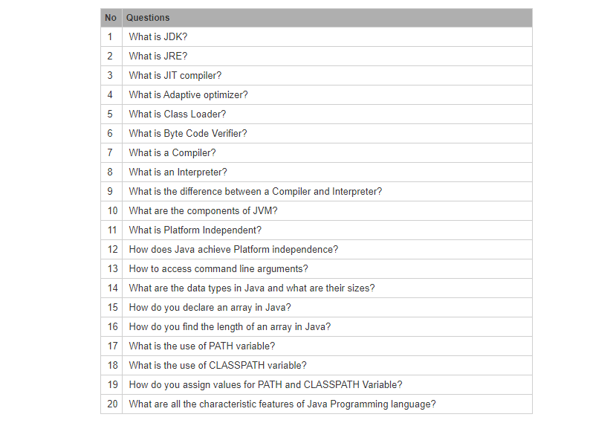

Slide 24
The JIT compiler
https://www.ibm.com/docs/en/ztpf/1.1.0.15?topic=reference-jit-compiler

Slide 25
Adaptive optimization
https://en.wikipedia.org/wiki/Adaptive_optimization

Slide 26
Java Classloader
https://en.wikipedia.org/wiki/Java_Classloader

Slide 27
What is bytecode verifier in java
https://www.oracle.com/java/technologies/security-in-java.html

Slide 28
What is Interpreter in Java
https://linuxhint.com/interpreter-in-java/

Slide 29
Difference between Compiler and Interpreter
https://www.geeksforgeeks.org/difference-between-compiler-and-interpreter/

